Slide 1
Young problems
by Karpuk Maksim and Telitsa Ilya(really person without addictions!)

Slide 2

Almost all problems are related

Slide 3
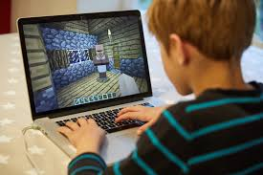

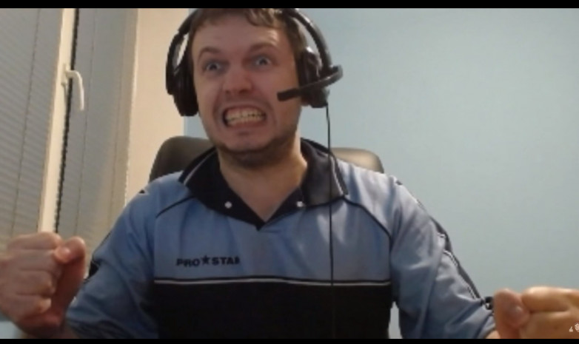
1. Video games addiction

Slide 4

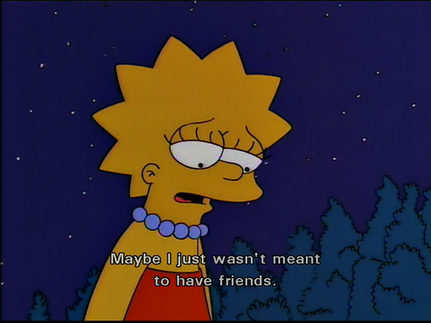
2. Problems in social life

Slide 5


3. Problems with studying or failure to succeed in education

Slide 6


4. Mental health problems

Slide 7


5. Substance abuse

Slide 8
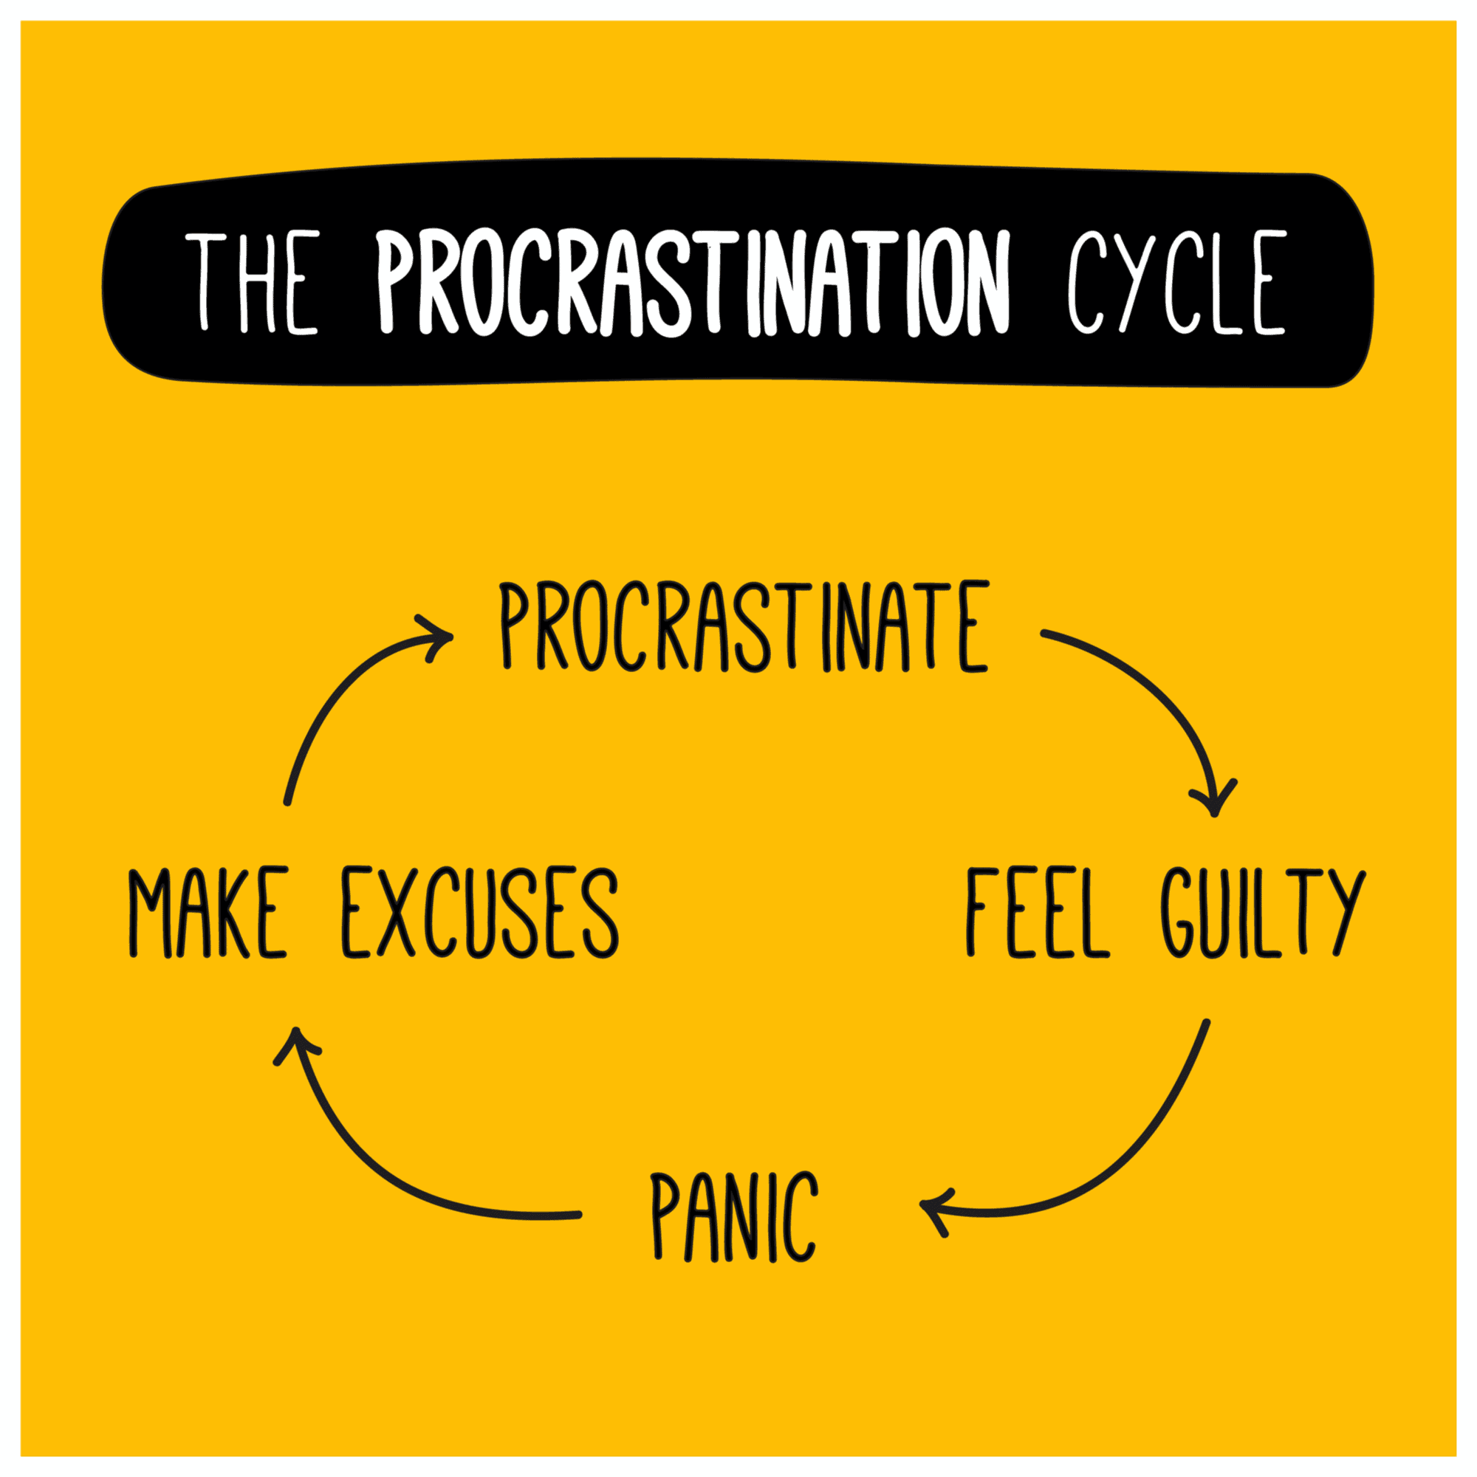

6. Procrastination

Slide 9

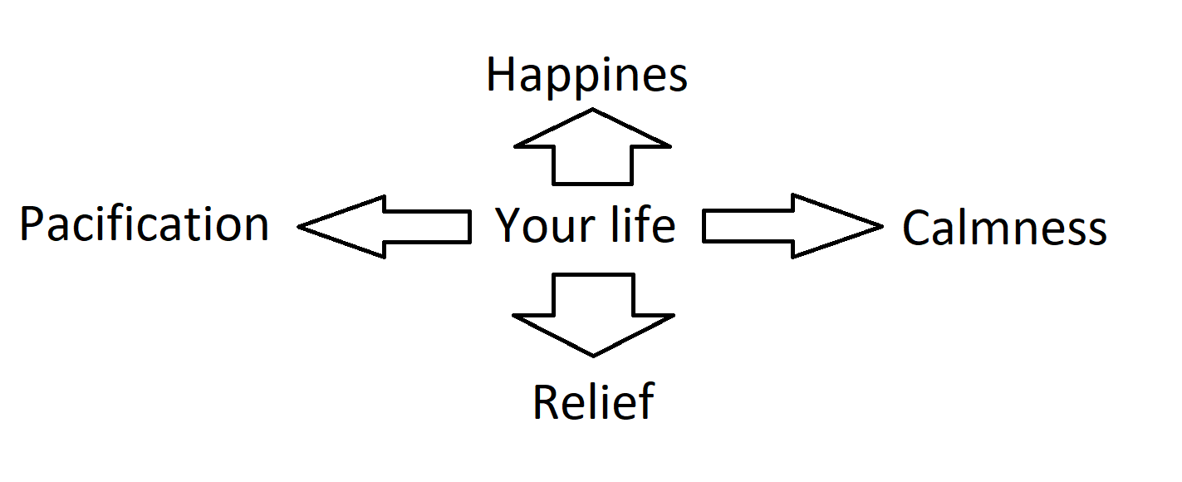
Before problem solving:
After problem solving:

Slide 10

THANKS FOR WATCHING!
Before presentation:

Slide 11

THANKS FOR WATCHING!
Before presentation:
After presentation:

